Slide 1

Introduction to agile
Sudeep Lal Bajimaya

Slide 2
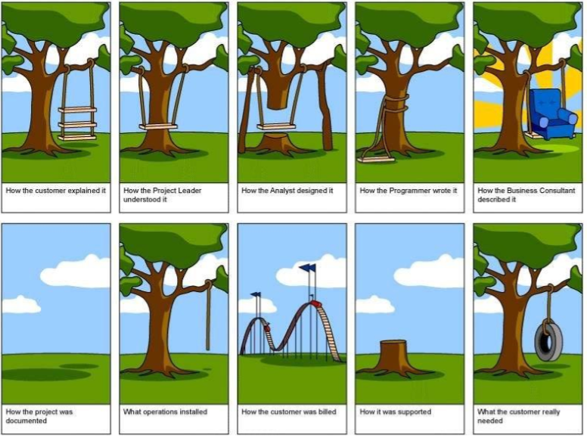

Slide 3
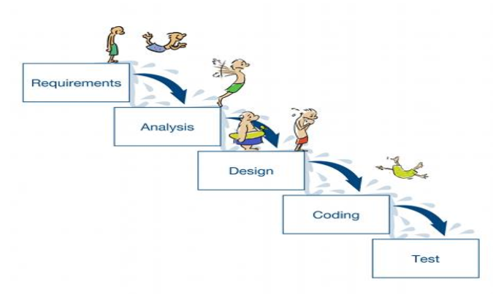
Do we recognize this?

Slide 4
It’s highly logical, but ….
Assumes correct or complete requirements are known at the beginning
Change is risky and costly, so new needs often can’t be met
Hand-offs between groups require work, and invite disconnects
Testing is done towards the end, when defects are a bigger problem
No working software until end of the process, so lots of surprises!

Slide 5
What is a defined process?
A defined process consists four major elements:
Steps and decisions — the flowchart. A series of steps and decisions describing the way work is completed.
Variability of processing time and flow — the pattern of processing times.
Timing and interdependence — when the arrivals happen, when people work, etc.
Assignment of resources — how many and where are they assigned.

Slide 6
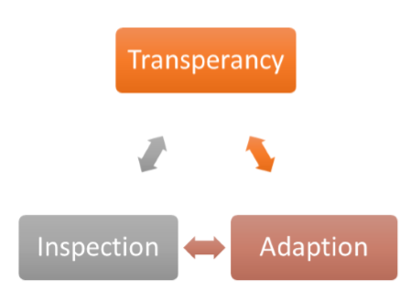
Empirical process
Decisions are made based on observation and experimentation rather than on detailed upfront planning.

Slide 7
What is agile?
?

Slide 8
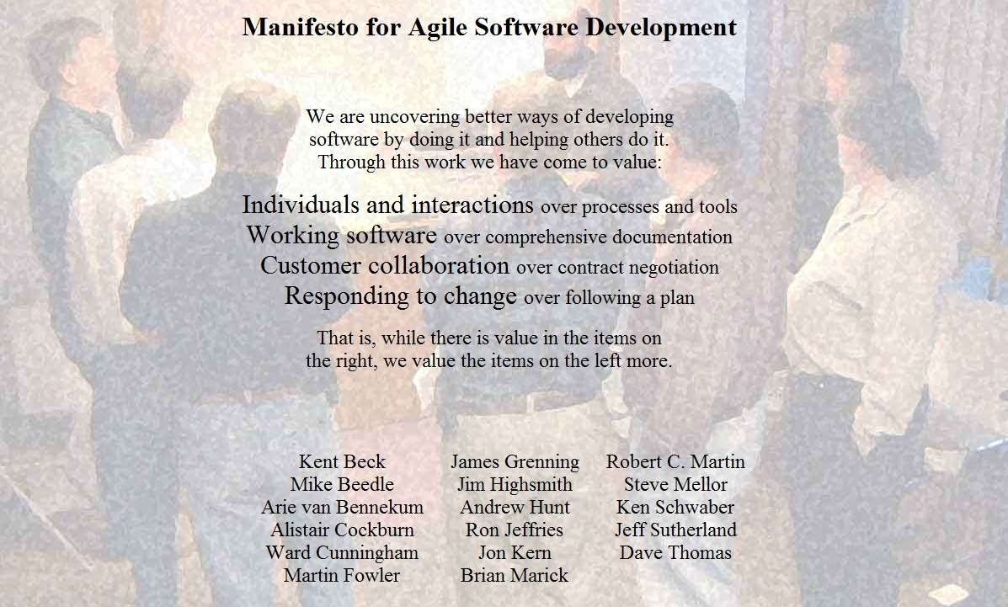

Slide 9
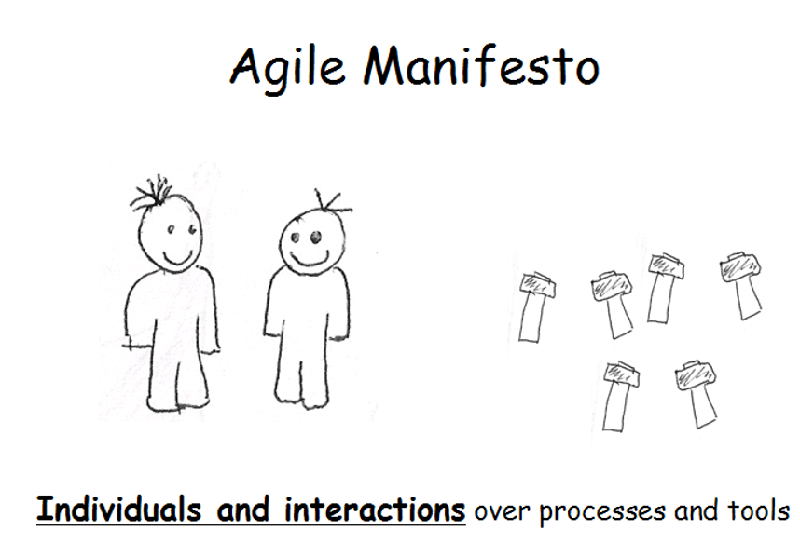

Slide 10
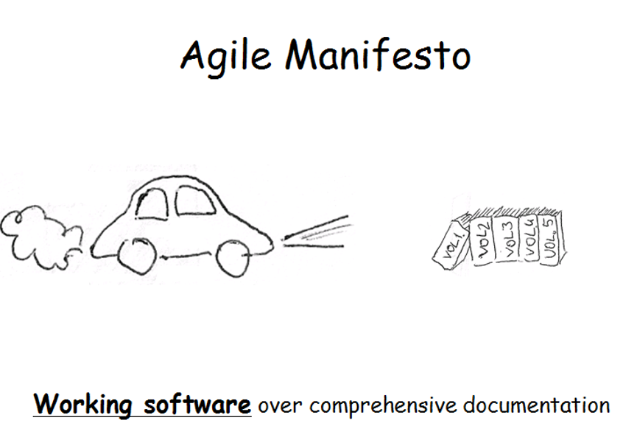

Slide 11
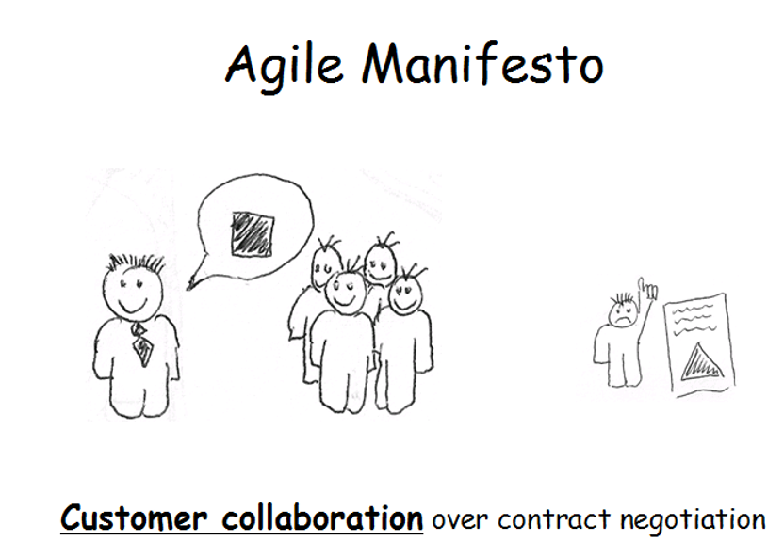

Slide 12
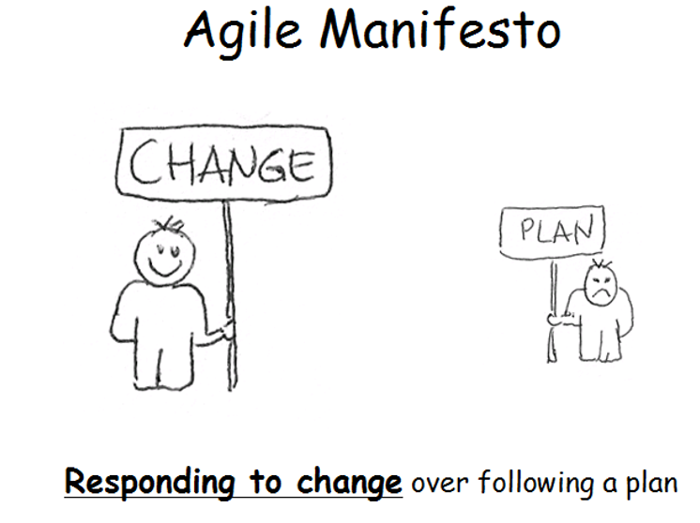

Slide 13
12 Principles of Agile

Slide 14

# 1. Customer satisfaction by rapid delivery of useful software

Slide 15
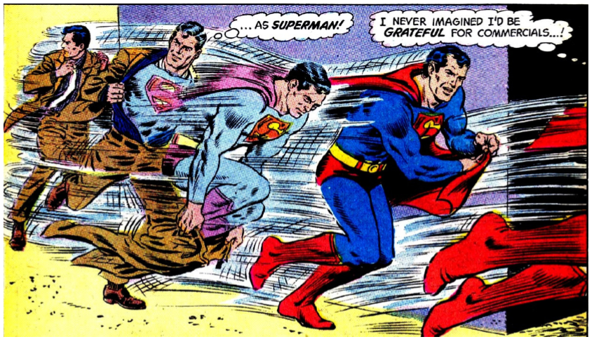
# 2. Welcome changing requirements, even late in development

Slide 16
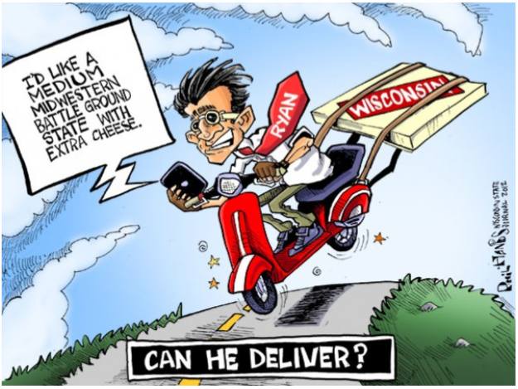
# 3. Working software is delivered frequently

Slide 17
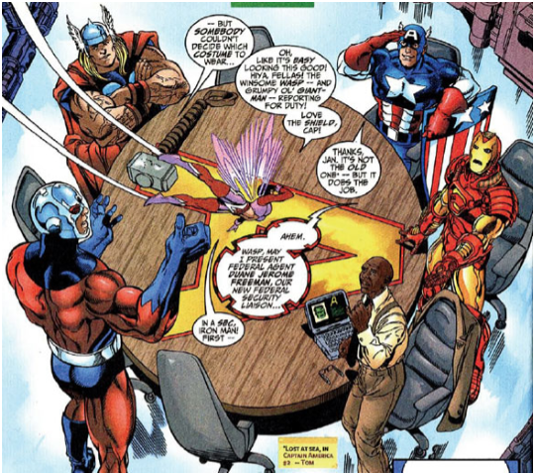
# 4. Close, daily cooperation between business people and developers

Slide 18
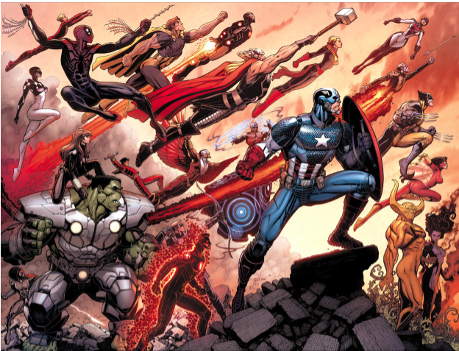
# 5. Projects are built around motivated individuals, who should be trusted

Slide 19
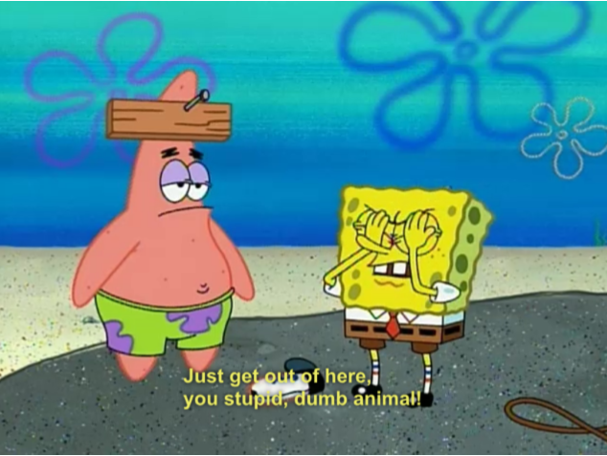
# 6. Face-to-face conversation is the best form of communication

Slide 20
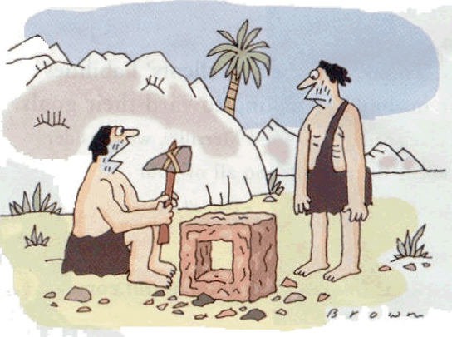
# 7. Working software is the principal measure of progress

Slide 21
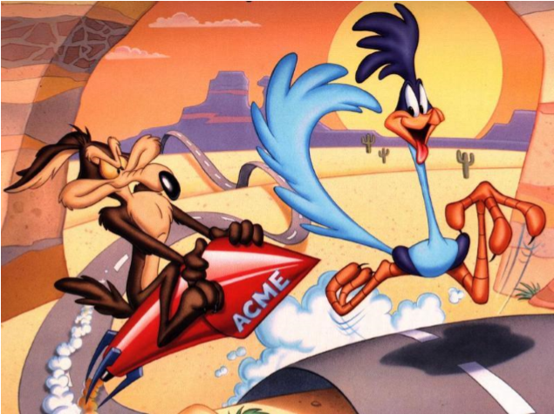
# 8. Sustainable development, able to maintain a constant pace

Slide 22
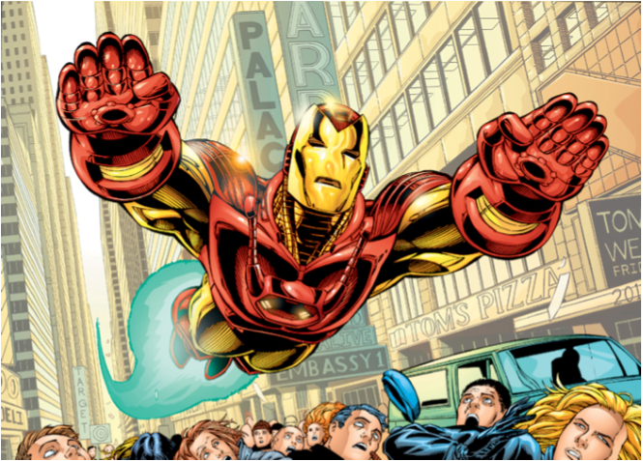
# 9. Continuous attention to technical excellence and good design

Slide 23
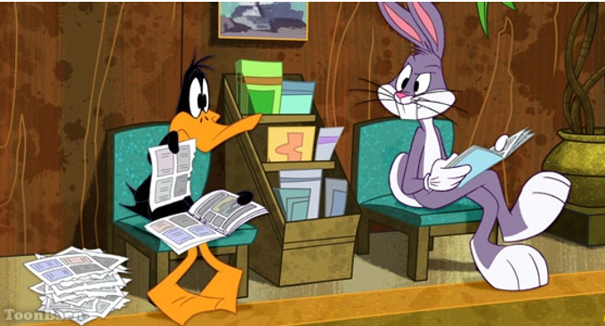
# 10. Simplicity—the art of maximizing the amount of work not done—is essential

Slide 24

# 11. Self-organizing teams

Slide 25

# 12. Regular adaptation to changing circumstance

Slide 26
The three aspects of agility
ESSENCE
Principles and values
DÉCOR
Practices
MYTHS
Agile But..

Slide 27
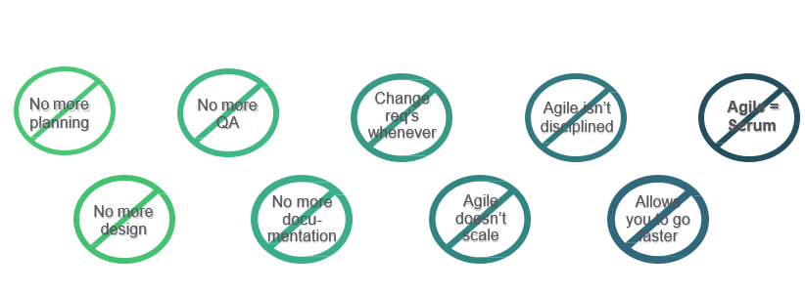
Common Fallacies (Myths)

Slide 28
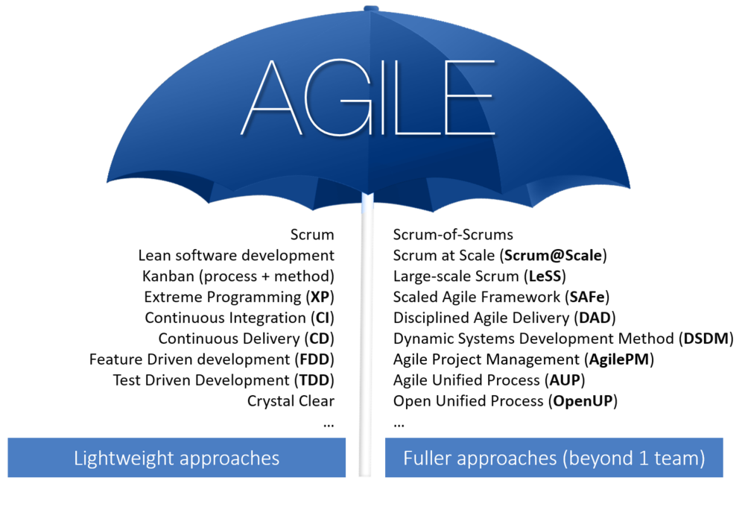
Agile frameworks and methodologies
Photo Courtesy: http://www.nmerge.com/agile -marketing-lightweight-or-a-fuller-approach

Slide 29
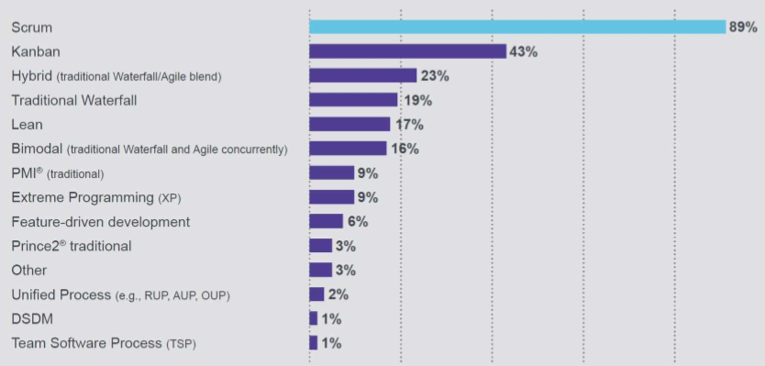
Popularity comparison
THE 2016 STATE OF SCRUM REPORT – SCRUM ALLIANCE

Slide 30
Reference and bibliography
M. Mizanur Rahman, CSD 2018.
E. Arisholm, H. Gallis, T. Dybå, and D. Sjøberg, "Evaluating Pair Programming with Respect to System Complexity and Programmer Expertise," IEEE Transacations in Software Engineering, vol. 33, no. 2, pp. 65-86, February 2007.
Cohn, M. (2004) user stories applied: for Agile software development. Person Addison Wesley.

